Slide 1



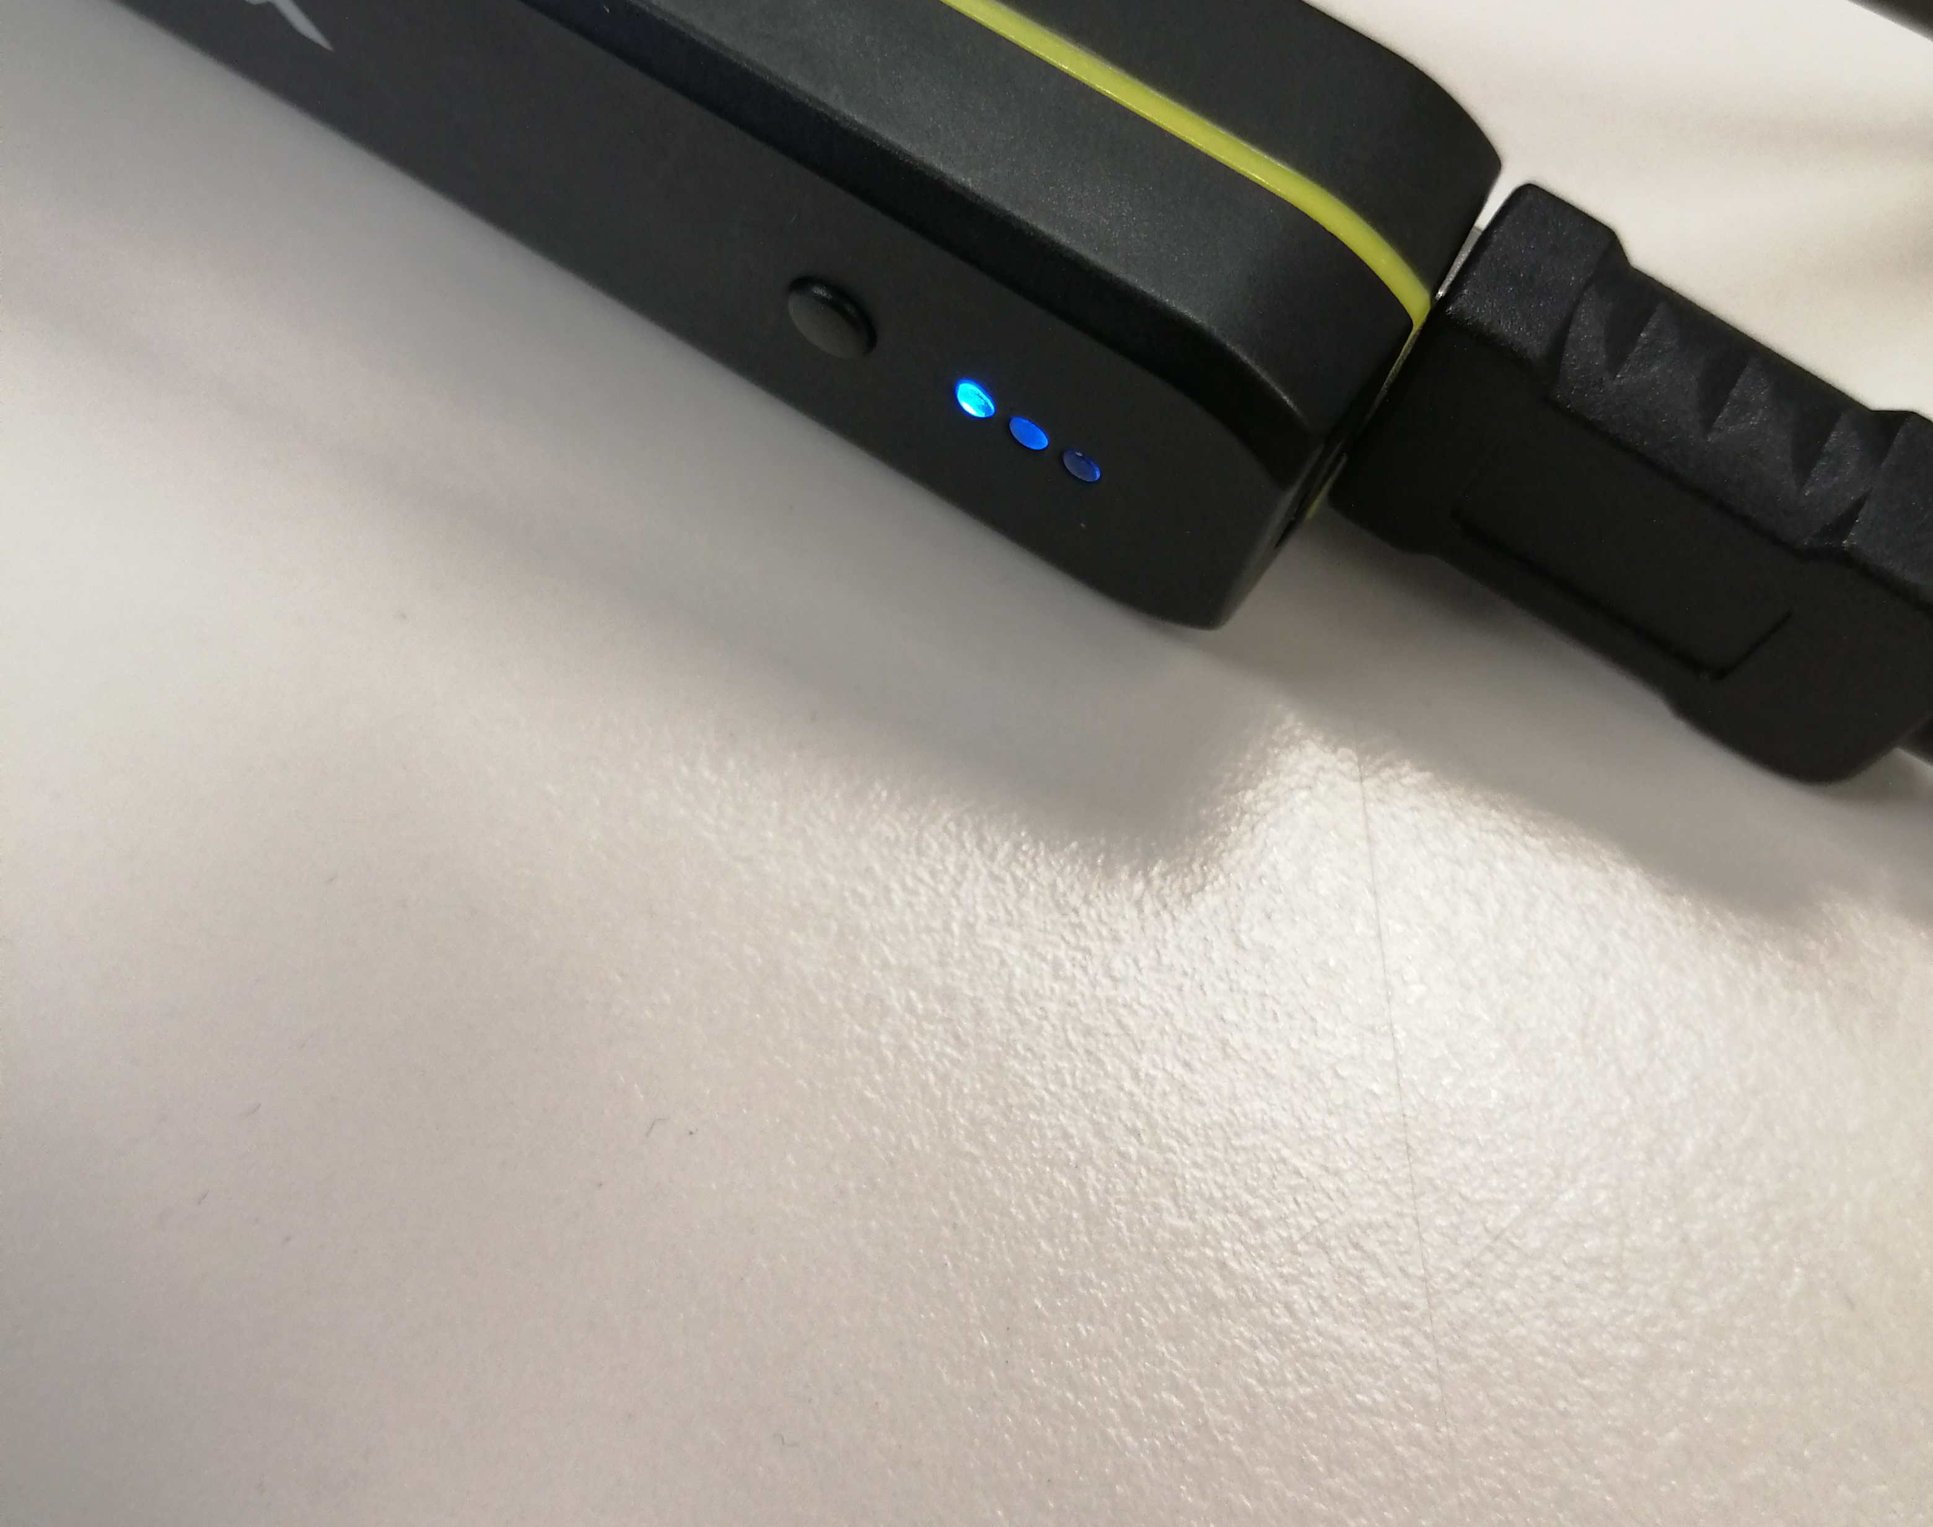
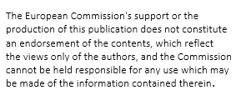
Battery on/off
To turn the battery on just press the button. To turn off the battery hold down the button until lights turn off momentarily.
If battery lights are blinking in any way the battery is off. If lights are static battery is on.

Slide 2
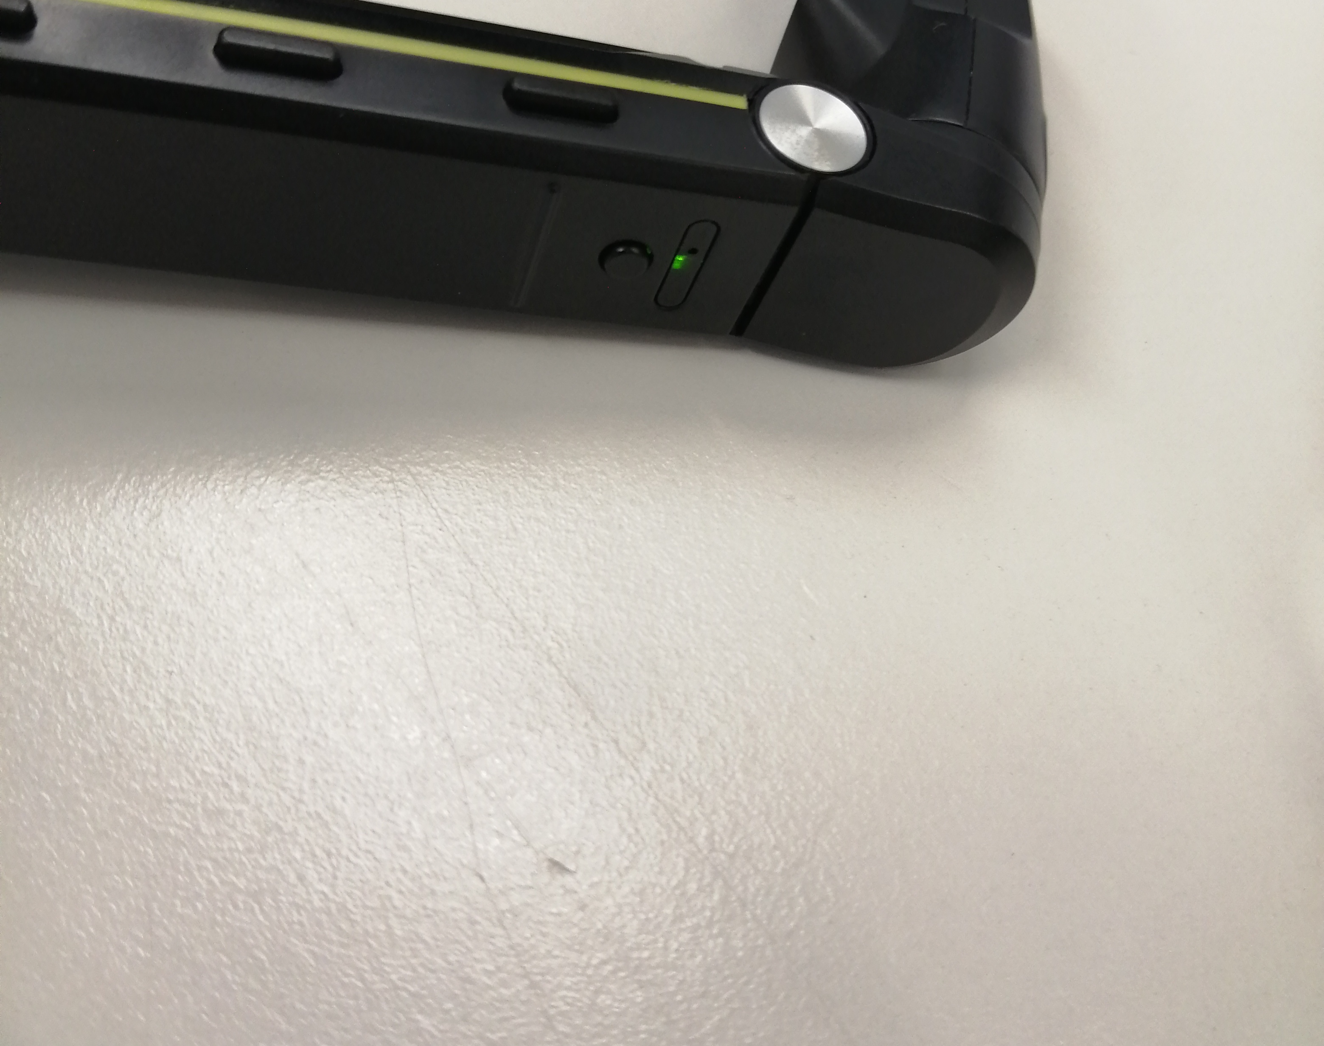
Screen on/off/sleep
To turn on the screen press the button on the side of the screen part until greenlight above the button turns on. Similarly, the screen is turned off by holding down said button until the green light above turns off.
Screen sleep mode is activated and deactivated by shortly pressing the button.

Slide 3
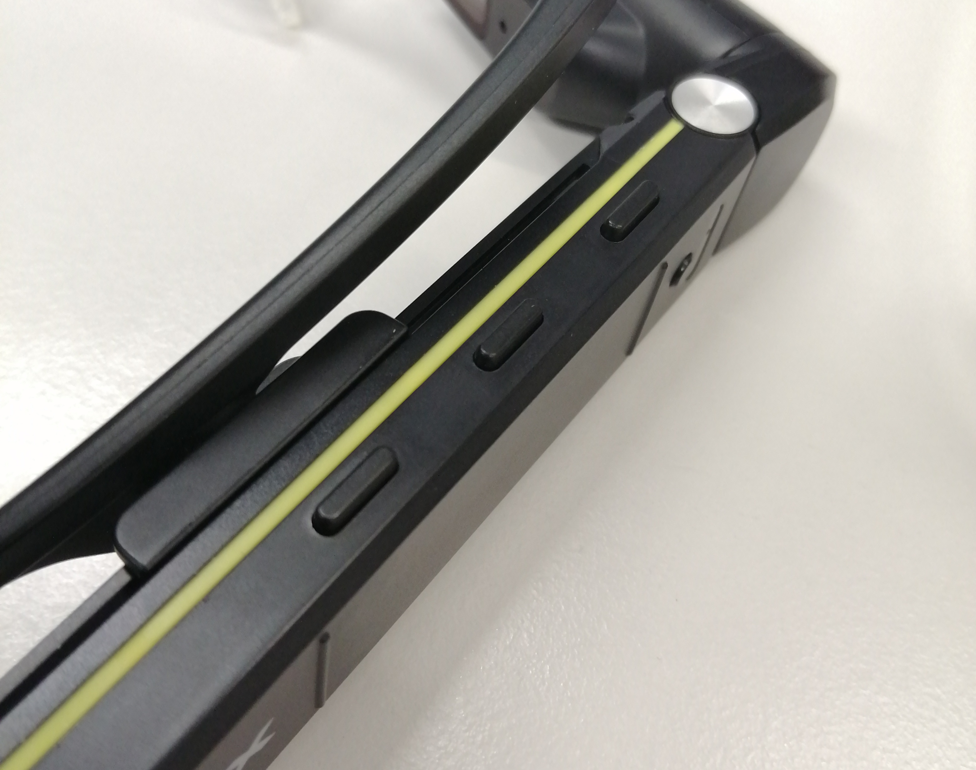
Screen operation
To use the screen there are three buttons on top of the screen part.
Button A is used to select applications.
Button B is used to scroll to the left and when in application to return to the menu when held down.
Button C is used to scroll to the right.
All these things can also be done with the input tab of the Vuzix companion app after connecting to the device.
C
B
A

Slide 4
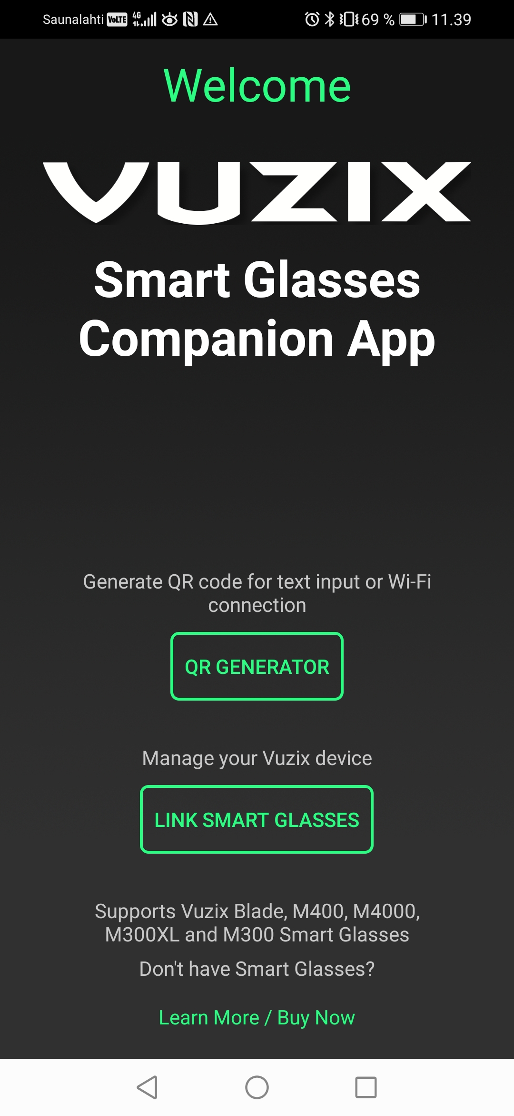
Vuzix companion app
The Vuzix companion app can be downloaded from the app store for free and it will make operating the glasses a lot easier.
The app will provide essential information such as the battery and wi-fi connection of the connected glasses. It is also a lot easier to connect to a wi-fi network using the app.
Connecting the app to the glasses is done by selecting "link smart glasses" and scanning the QR code that appears with the scanner app in the glasses

Slide 5
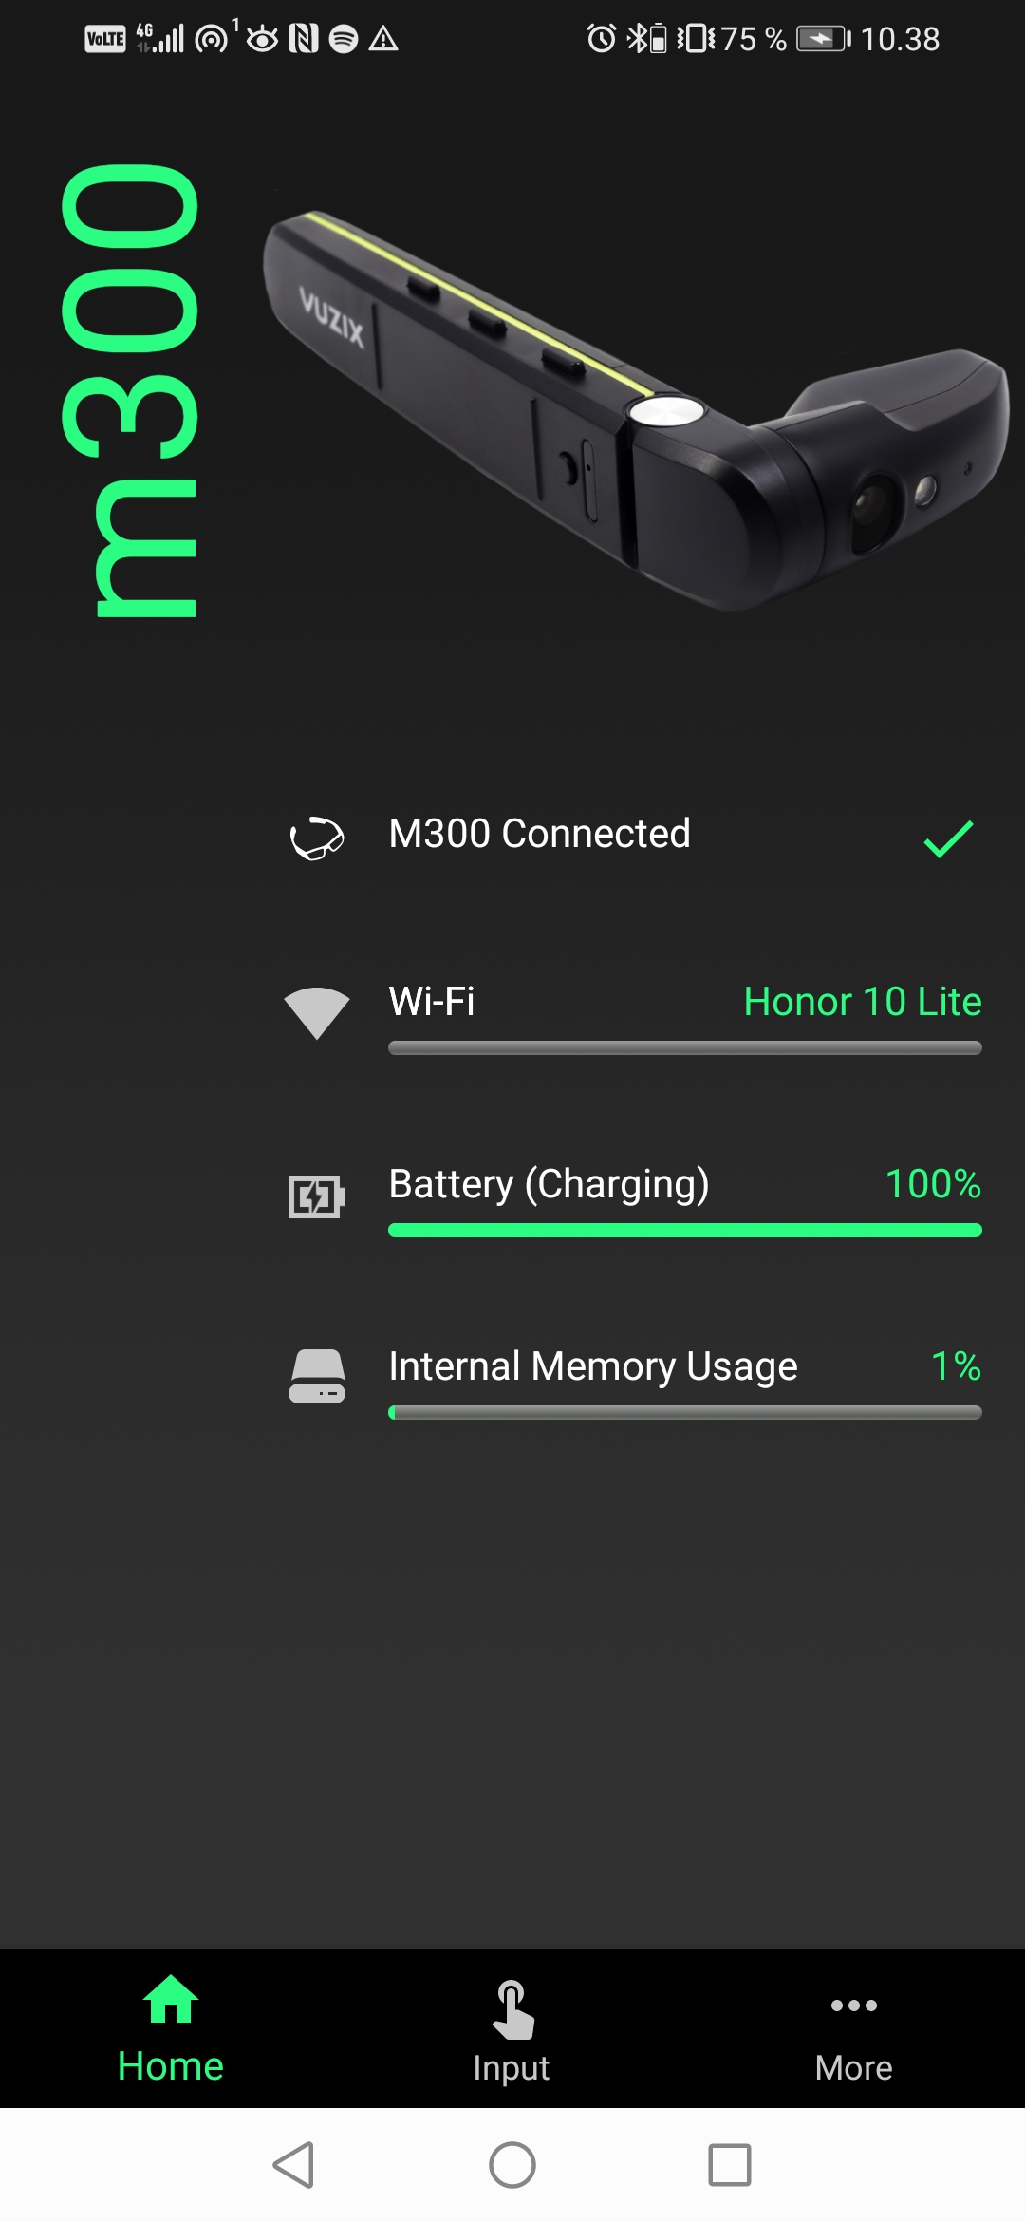
Vuzix user interface: home
In this picture is the first thing you see after connecting the glasses to your device with the QR code
The home tab is general information about the connected glasses.

Slide 6
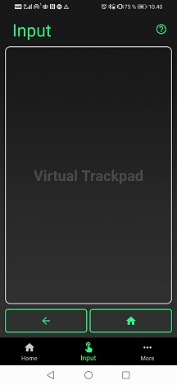
Vuzix user interface:
Input
The input tab is where you can use the glasses from your phone.
The arrow is a "back" button that takes you back to the last place you were within the selected application.
The button with a house icon takes you back to the application selection screen.
The virtual trackpad is used identically to a laptop's touchpad. By dragging your finger on it you can move the cursor that appears. By tapping the trackpad, you can select thing with the cursor. By dragging two fingers across the trackpad, you can scroll to which ever direction you are dragging.

Slide 7
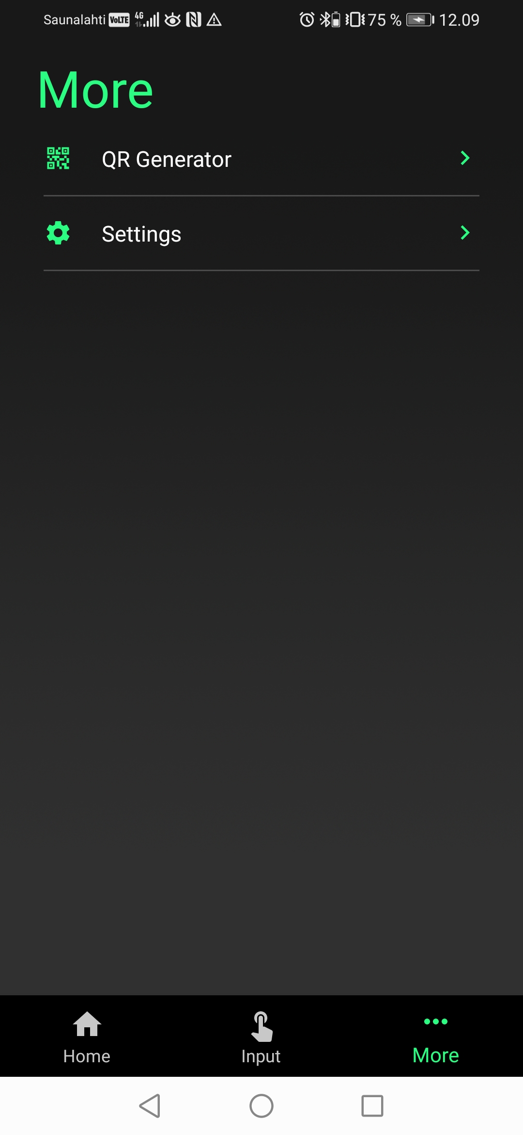
Vuzix user interface:
More
In the more tab you can find the QR generator and settings.
With the QR generator you can copy and paste internet links and have them converted into QR codes which the scanner app in the glasses can read.

Slide 8
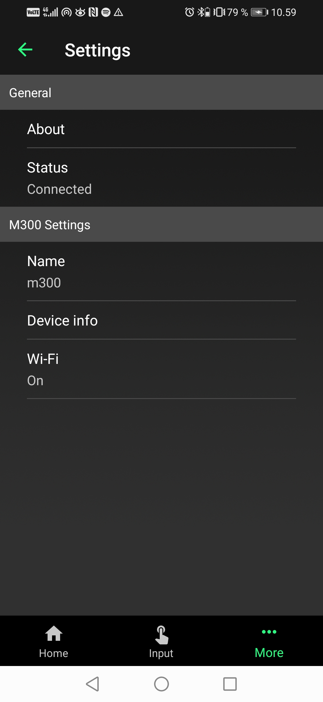
Vuzix user interface: settings
In the setting you can go to:
About to contact support and read legal mumbo jumbo.
Status to disconnect from the glasses.
Name to change the identification name of the glasses
Device info to see IP-addresses and serial numbers.
Wi-Fi there you can connect and disconnect from Wi-Fi networks.

Slide 9
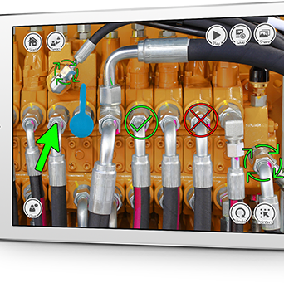
Pointr app
Pointr is a video calling app that allows callers to put symbols and texts easily onto the video call allowing for clearer communication and instruction.
Pointr can be downloaded from the app store for free.

Slide 10
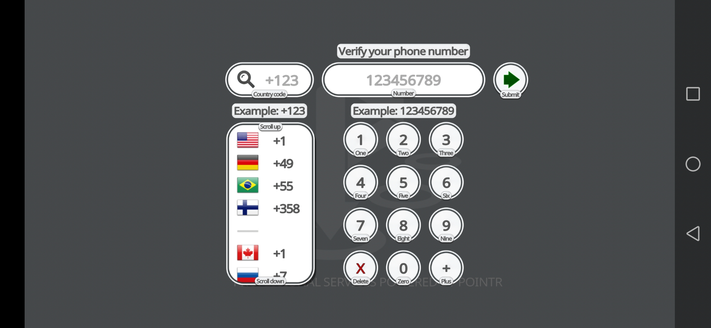
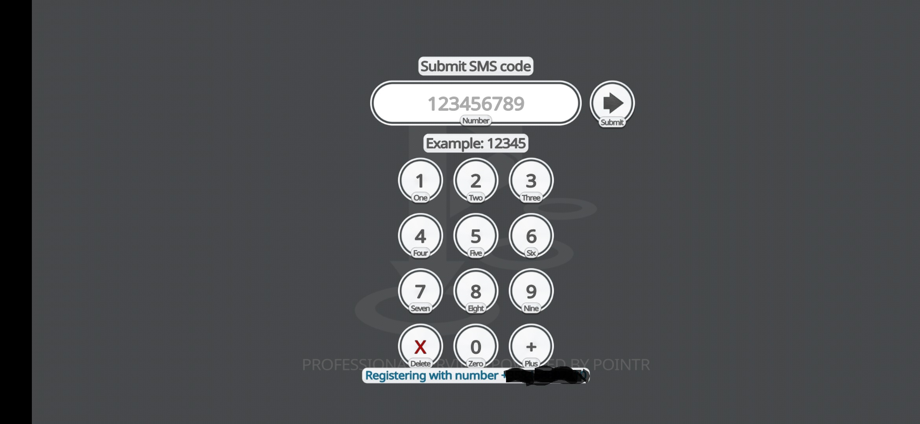
Opening Pointr for the first time
When opening Pointr for the first time it will ask you for your phone number and e-mail address when these are given, and the security code received via text message has been entered you can create an account after which you can access all the apps features.

Slide 11
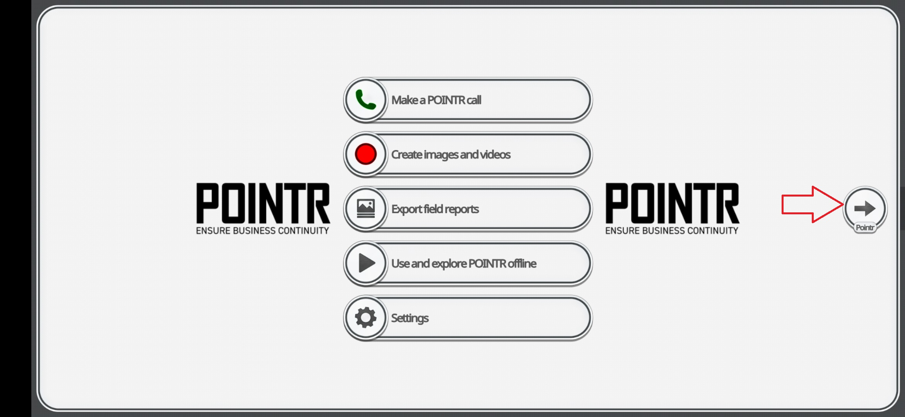
Pointr user interface: start
This is Pointrs starting screen. for these tasks, the only relevant part is the button on the right indicated by the red arrow.

Slide 12
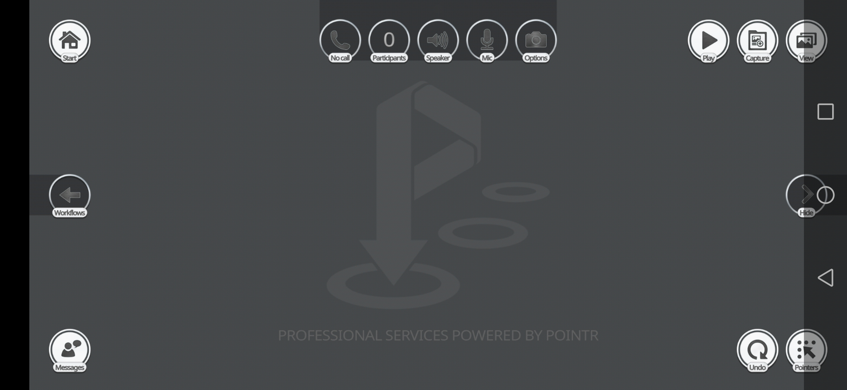
Pointr user interface
This is the basic call view and most of the buttons in this screen are self-explanatory but the most important are the start and pointers tabs.

Slide 13
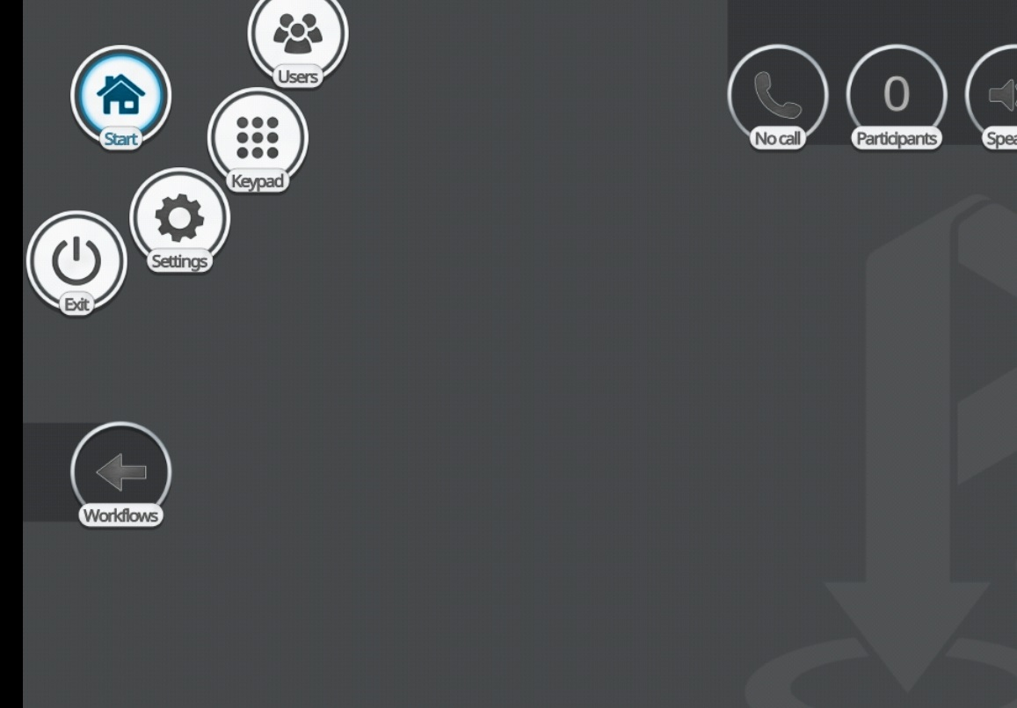
Pointr start tab
In the start tab are the users tab, the keypad, settings and the exit button. In the users tab you can call yourself or people from your contact list. With the keypad you can call anyone who has the Pointr app just by inputting their area code and phone number.

Slide 14
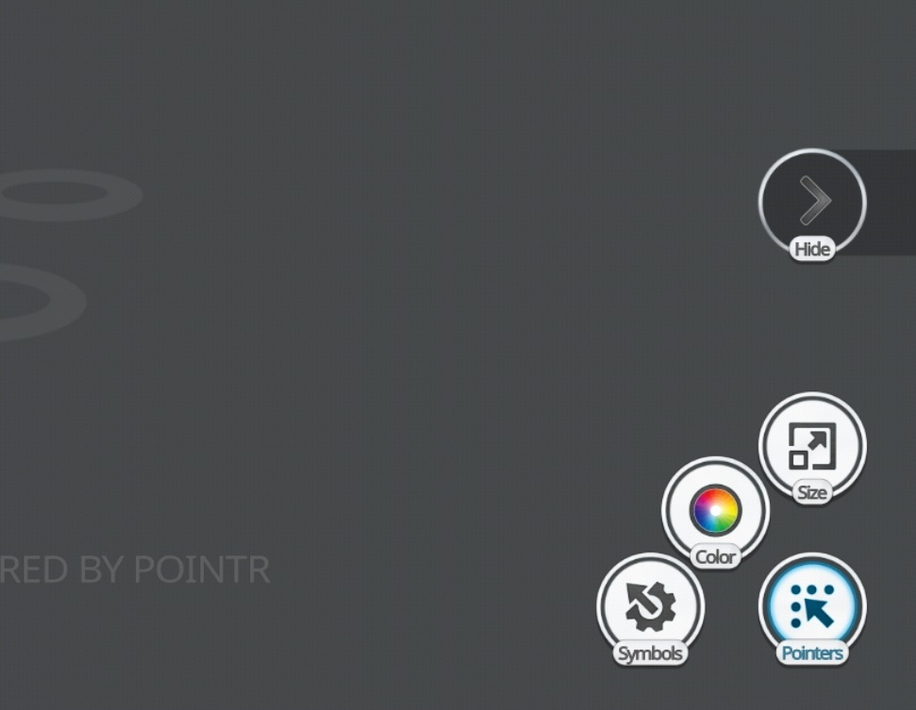
Pointr pointers tab
In the pointers tab you can put different kinds of symbols, draw and type texts on the call from the symbols tab. The color tab is for selecting the color for the symbol's, brushes and texts. And size is for selecting the size of the symbols.
Pointers can be taken off the screen by using the undo button that is next to the pointers button when it is unselected. Drawings can be erased with the eraser tool in the symbol's tab.

