Slide 1


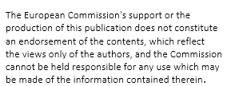
Pointr & Vuzix M300
Augmented reality and how you can use it

Slide 2
Pointr
An application that allows remote communication between different devices
Helpful when a technical problem needs to be solved quickly
  For example on a ship, truck, during assembly work or maintenance
Computer – phone connection
Computer – smart glasses connection
Smartphone – phone connection
Smartphone – smart glasses connection

Slide 3
Pointr
Where you could use Pointr:
  Remote help
  - With maintenance and assembly work
  Remote teaching
  Remote sales
  - Customer gets first hand experience with a product/service
What you can do in Pointr:
  AR-markings
  Group call (max 5 participants)
  Help remotely / teach
  Display photos, videos and notes.

Slide 4
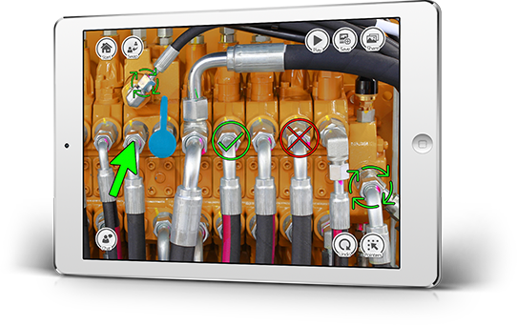
In practice

Slide 5
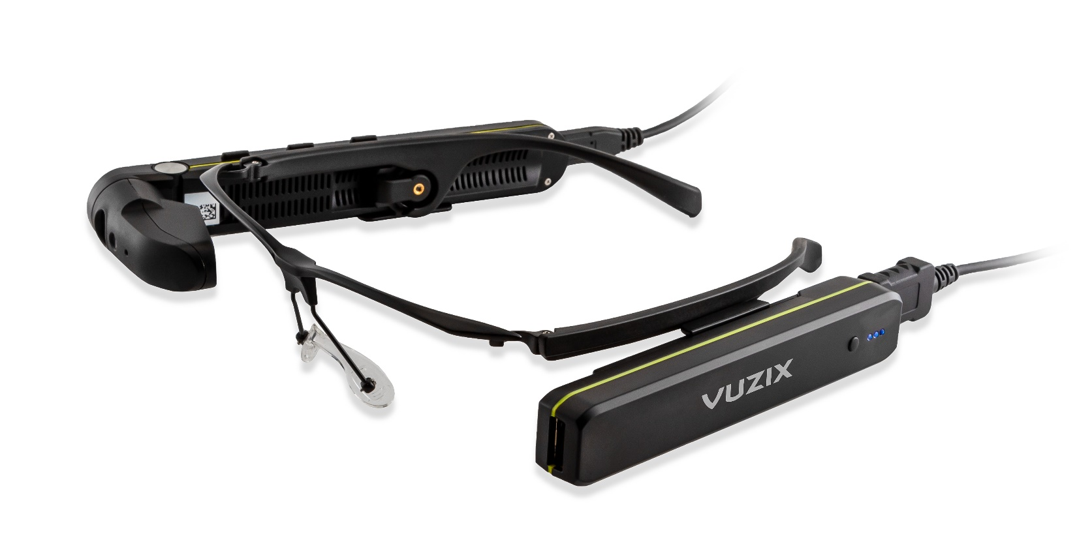
Vuzix M300XL

Slide 6
What, where and how?
Vuzix M300XL smart glasses provide a hands-free platform for digital information processing and collaboration
Develop existing workflow processes and open up new opportunities in industry, medicine, retail, logistics, remote management and other areas of your business
The Vuzix M300XL Smart Glasses is an ergonomically designed and rugged Android-based wearable computer
They have an improved the display, processor, storage capacity and wireless connectivity.

Slide 7
What, where and how?
Pre-installed applications can be used to track scheduled events, manage your calendar, connect your phone, etc. The HD camera captures images, low quality videos and can also be used as a barcode reader.
The Vuzix M300XL smart glasses offer most of the features and capabilities of current smartphones in a hands-free package.
Bluetooth 4.1 connectivity makes it an ideal pair for Android or iOS devices. You can also connect the glasses to a wifi network.
The Integrated head movement tracking gives applications the ability to scroll and move around the visible cursor thus making the operating easier.
The Vuzix M300XL smart glasses have voice, touchpad and button control as well as resistance to water, dust and dirt

Slide 8
Vuzix M300XL Specs:
Optic: 640x360p nHD screen, 16: 9 aspect ratio, brightness > 2000 nits, supports left or right eye, 2-core Intel Atom processor, 2GB RAM, Android 6 operating system, 64 GB internal flash memory
Controlling: Four Android control buttons, voice control - customizable and available in multiple languages, two-axis touchpad
Integrated head tracking : Three degrees of freedom head tracking, 3-axis gyro, 3-axis accelerometer and 3-axis integrated compass
Audio: Dual noise-canceling microphone and speaker

Slide 9
More specs:
Battery: 160 mAh internal battery, 860mAh external battery, USB power supply, 2-12 hours operating time depending on external battery selection
Camera: Up to 10 MP images, 1080p video, autofocus, optical image stabilization and flash
Versatile installation options : Eyeglass frames with or without lenses, safety goggles, helmet mount, headband mount
Connectivity: MicroUSB 2.0, Wi-Fi, Bluetooth 4.1

Slide 10
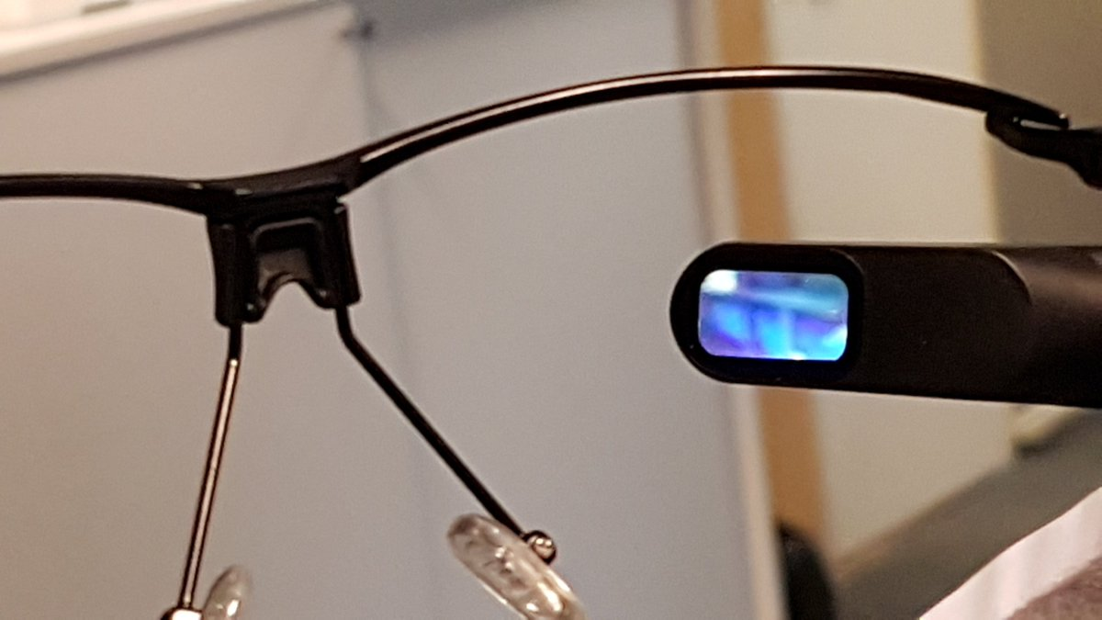
What the user sees:

Slide 11
Testing and learning
Download Pointr app from your phones own app store and do the preparations as seen in the next slide
Call your friend
Test different options in software with AR-guidance
Start the competition with phones
Download Vuzix (companion link) and do the preparations
Call your friend
Test different options in software with AR-guidance
Start the competition with phones and glasses

Slide 12

Pointr
To install Pointr go to either Google Play Store or App Store and search "POINTR Easy Remote Support".
Once in the app:
1. Enter your country code
2. Enter your phone number
3. Enter the code you recieved via text message
4. Enter your email address
5. Enter the code you recieved via email
Now the registration is done. Press Start > Keypad > Enter the persons country code and phone number you want to call.

Slide 13
Solve the burr puzzle with your pair 1/2
This task includes instructions on how to assemble the puzzle
One student gets unassembled puzzle and the other student gets the instructions
Pair is sitting back to back and cannot see each others. You have to communicate only by speaking.
Fastest pair to solve the puzzle will win a prize!

Slide 14
Solve the burr puzzle with your pair 2/2
Test the glasses with your pair
Change it other way around. Other student now has instructions and the other student burr puzzle
Pairs are sitting back to back and cannot see each others. You are only able to use Pointr software and it´s content and features.
But now the assembler has both hands in use and instructor is seeing what is happening infront of the assembler.
How long did it take now?
The pair who reduced the most time will win a prize!

Slide 15
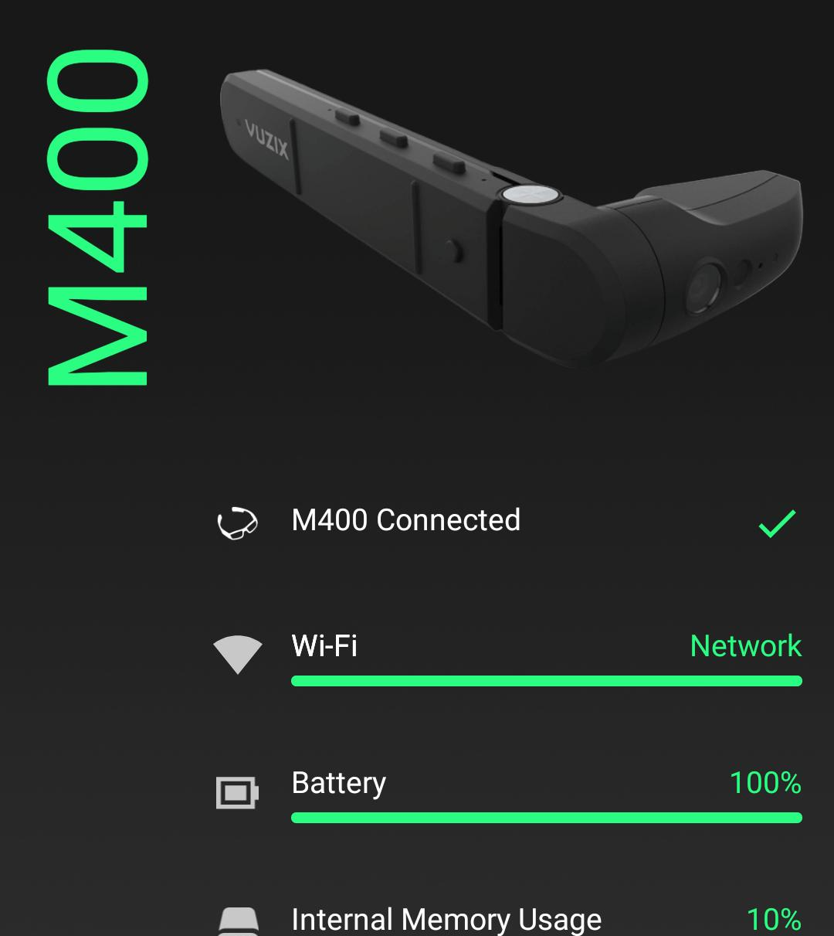
Setting up your M300XL
Once you have assembled your M300XL smart glasses you can begin setting up your mobile device by downloading the Vuzix Companion app either from Google Play Store or App Store. Once in the app you can connect to the glasses and control the operating system.
The next step is to connect the glasses to a wifi/data hotspot via the glasses own settings. This step is required to download applications and update the glasses software if necessary. It's also required if you are going to participate in any sort of videocalls.
Above is pictured the Vuzix M400 Smart Glasses in the Vuzix Companion app.

