Slide 1

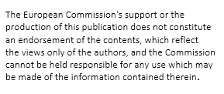
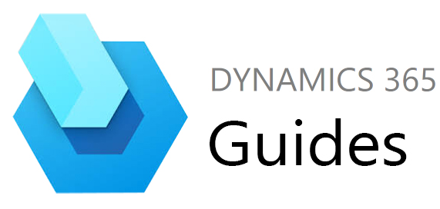








Operating Instructions
Ausbildungspartner

Slide 2





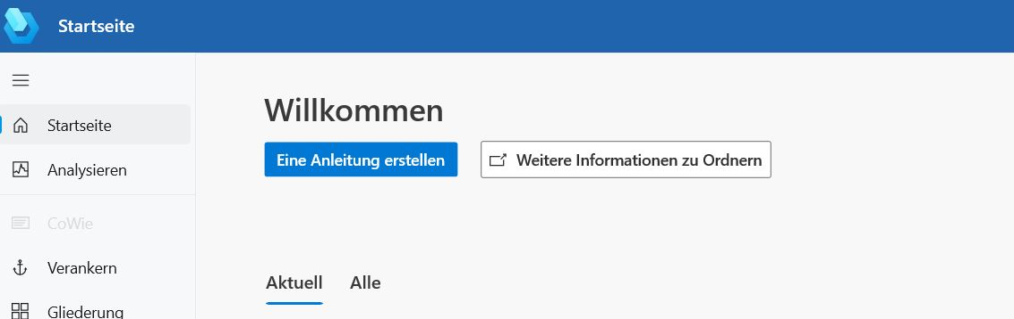
1. Step:
- Open Dynamics 360 Guide
2. Step:
- Create a new manual
Training partners
Notes:
05.10.2023
2

Slide 3
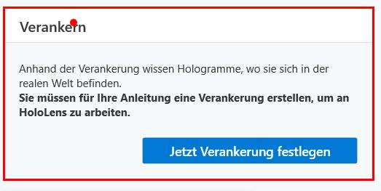
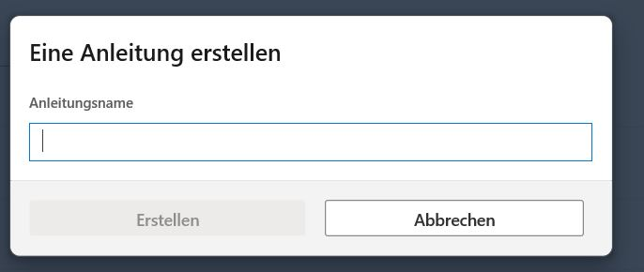
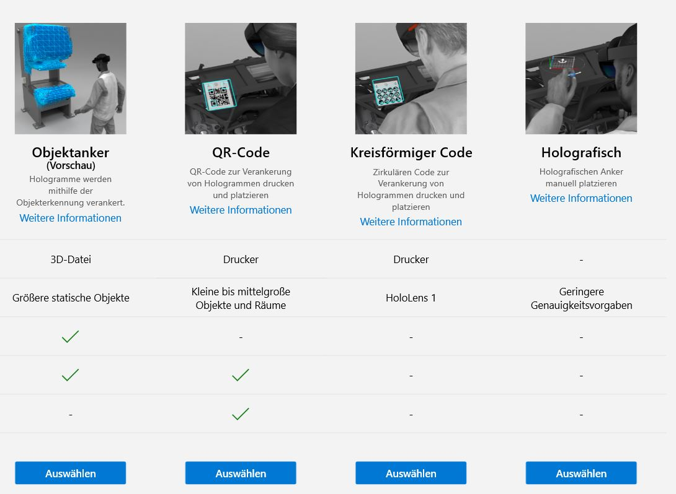
3. Step:
- Give the instruction a name
4. Step:
- Select and define anchoring
Training partners
Notes:
05.10.2023
3

Slide 4
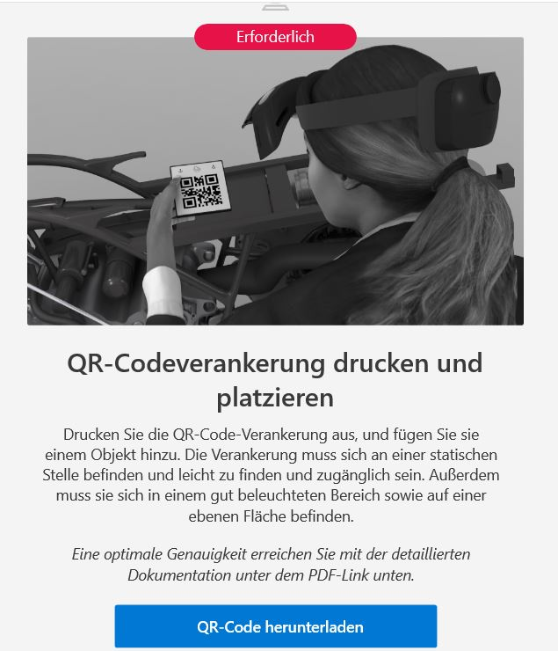
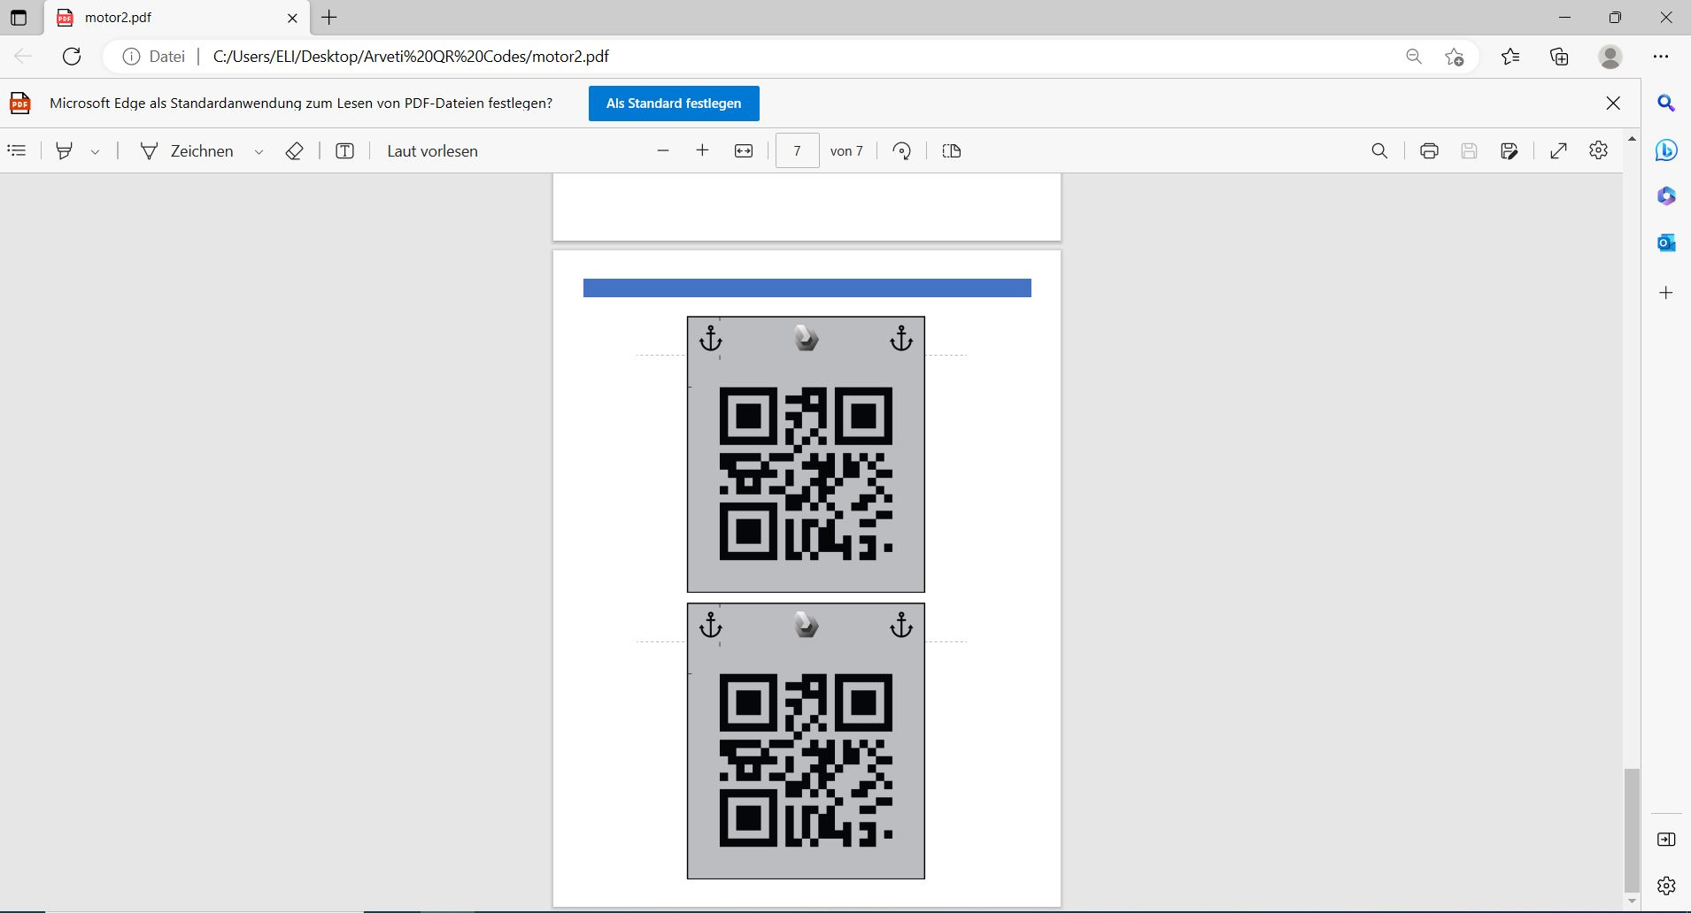
5. Step:
- Select anchoring “QR code”
6. Step:
- Save and print QR code
Training partners
Notes:
05.10.2023
4

Slide 5
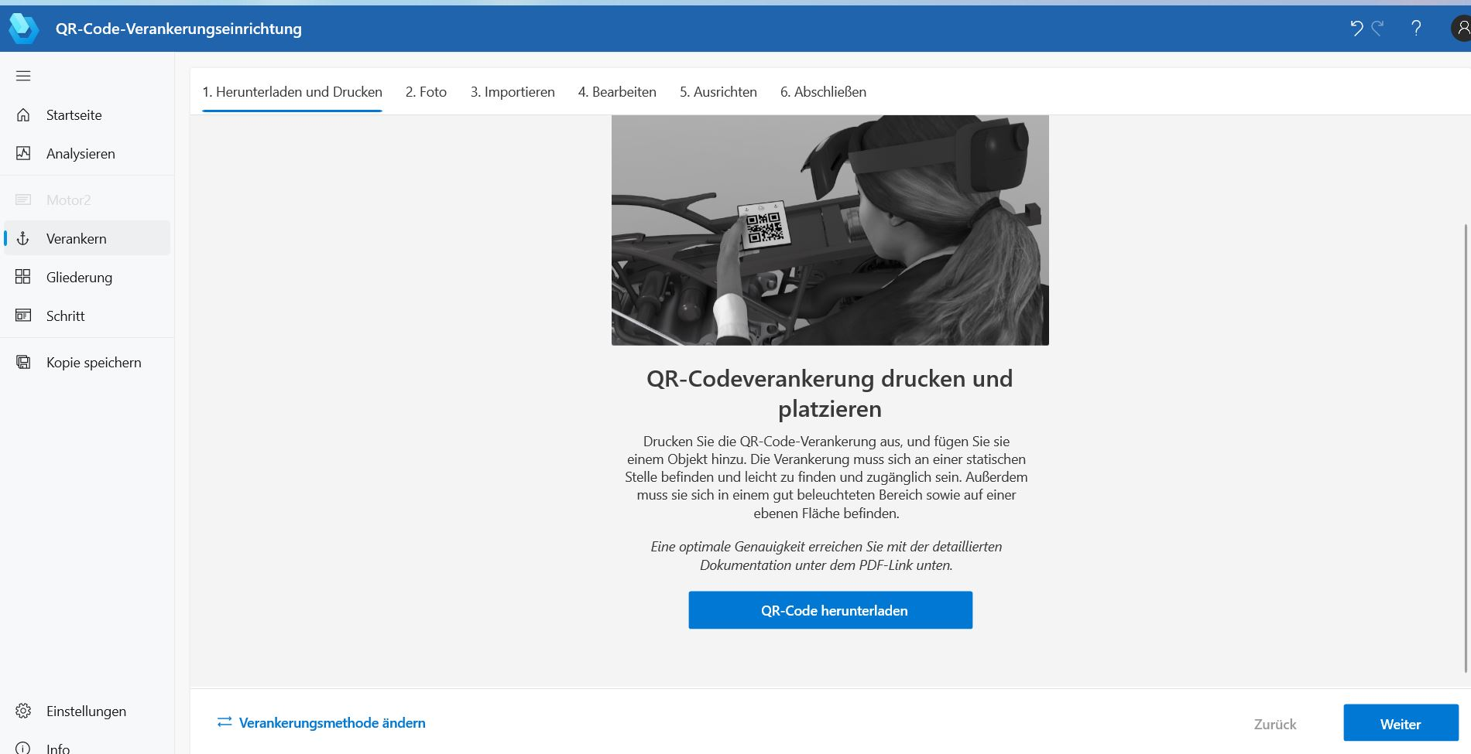
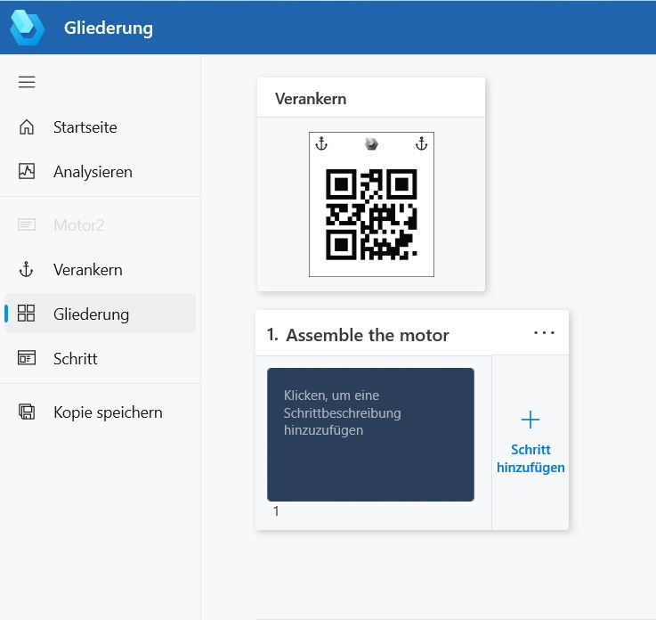
7. Step:
- Open Structure
8. Step:
- Task Name Assigned
Training partners
Notes:
05.10.2023
5

Slide 6
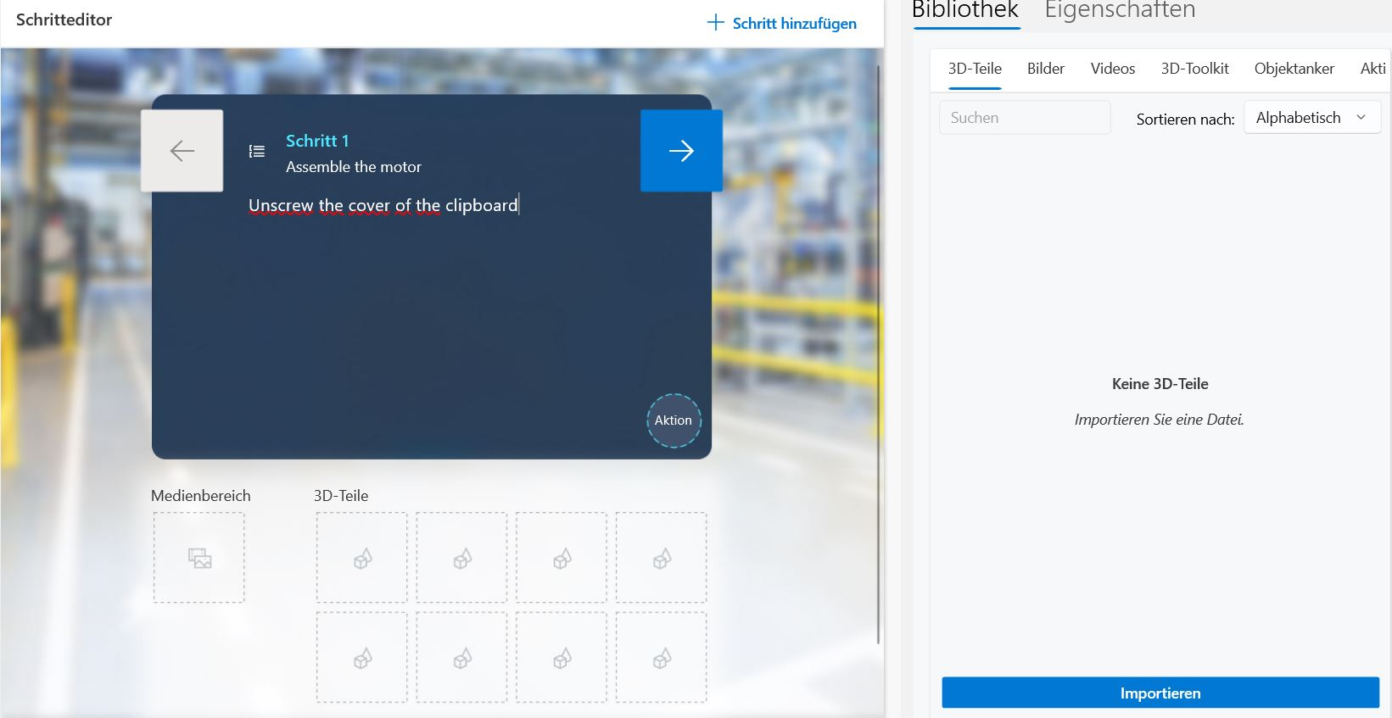
9. Step:
- Open “Step“
10. Step:
- Add description ‘Step 1’
Training partners
Notes:
05.10.2023
6

Slide 7
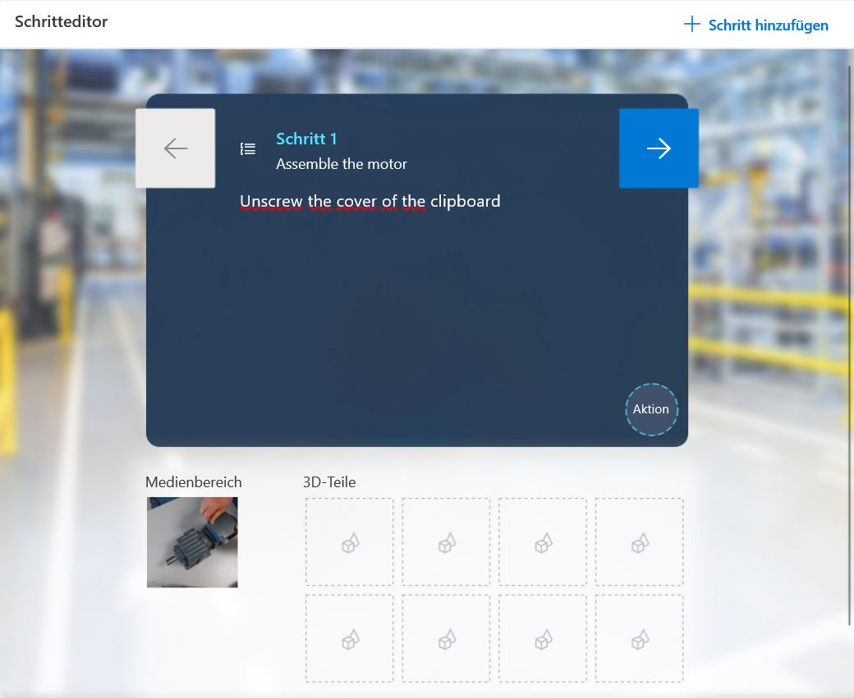
13. Step:
- Insert a photo from the Guides library by “drag and drop”
Training partners
Notes:
05.10.2023
7

Slide 8
14. Step:
- create further steps
15. Step:
- repeat the above steps and have fun ☺
Training partners
Notes:
05.10.2023
8

Slide 9
Testing the HoloLens :
Launch the HoloLens
Look at the palm of your hand -> open the menu -> open Dynamics Guide
Select the manual you have created
Scan the printed QR code with the glasses
Execute your instructions
Training partners
Notes:
05.10.2023
9

