Slide 1






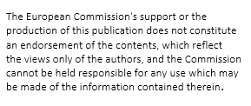
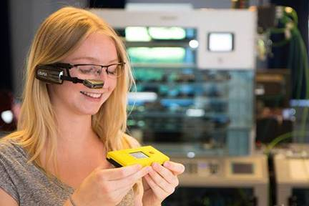







virtual reality in
Vocational Education and training
in the Industry 4.0 – ARVETI4.0
2020-1-DE02-KA202-007497
Ausbildungspartner

Slide 2
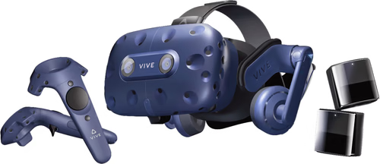
contents
introduction
AR component testing
VR farming simulator
    idea
    implementation
    outcome

Slide 3
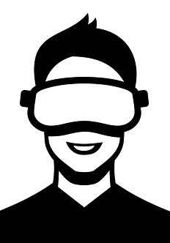
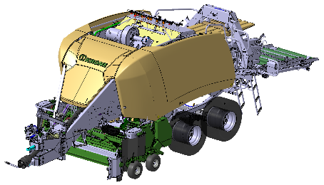


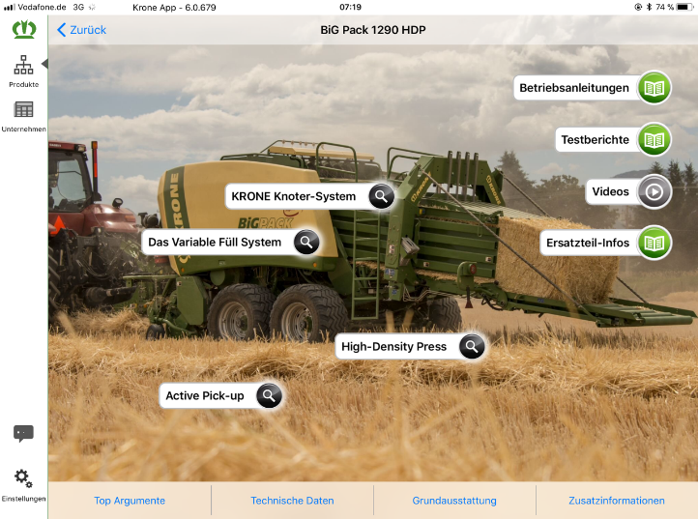
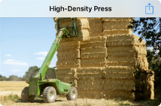
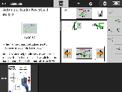

idea of usage of AR and VR technology
Creator: Construction
& Development
Processor: Technical
documentation
User
AR
service
Information processing /
-provision
VR
training
Operating manual
Krone App
Digital twin
terminal
portal- RMI

Slide 4
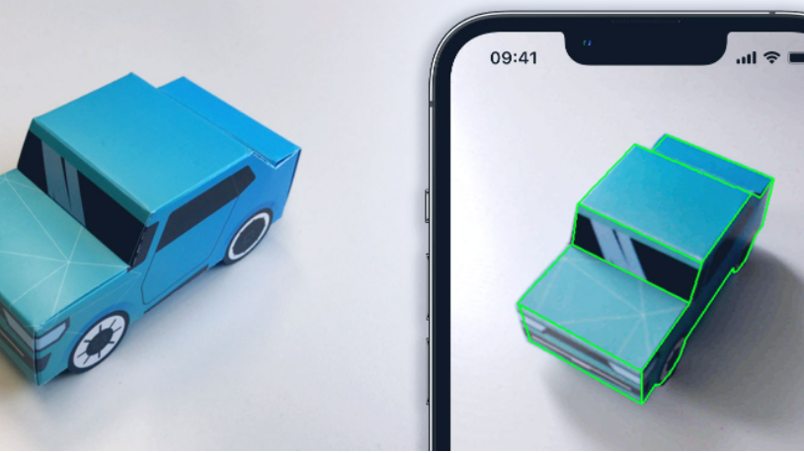
VisionLib
Krone works with an app, which puts 3D drawings on delivered parts
easy way to see mistake and deviations
VisionLibcompaning is the simple version of this system

Slide 5
advantages of the system
fast testing of components and assemblies for completeness and relative dimensional accuracy without set-up times
materials to be tested do not have to be transported and can be tested on site
the variety of different models can be checked quickly

Slide 6

AR: Component testing

Slide 7
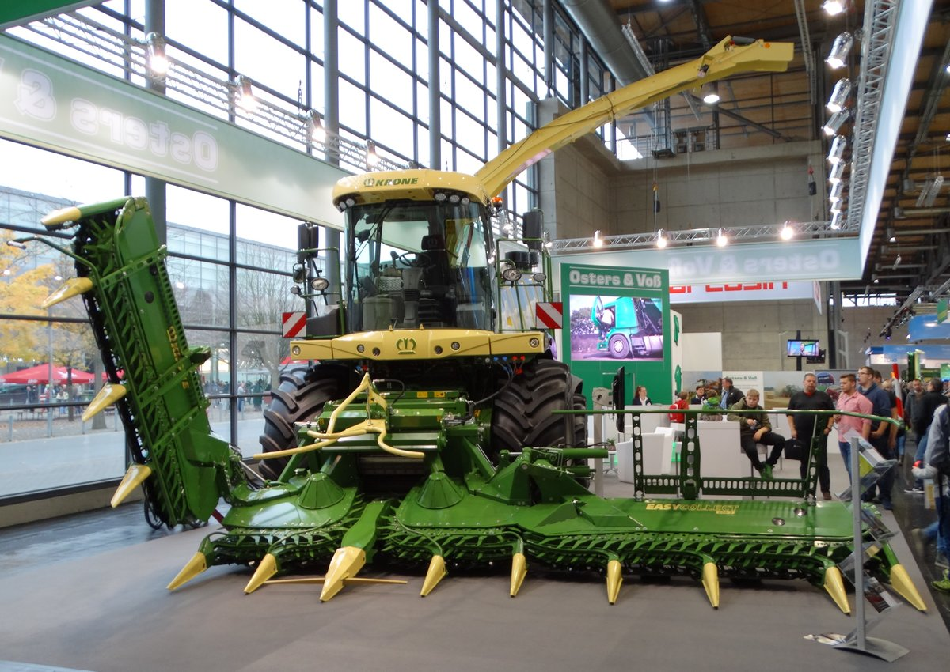
farming simulator
idea: hooking up our farming simulator with our VR Headset
  will be used as an attraction to recruit new apprentices on events like Agritechnica
  could be used for giving machine trainings

Slide 8
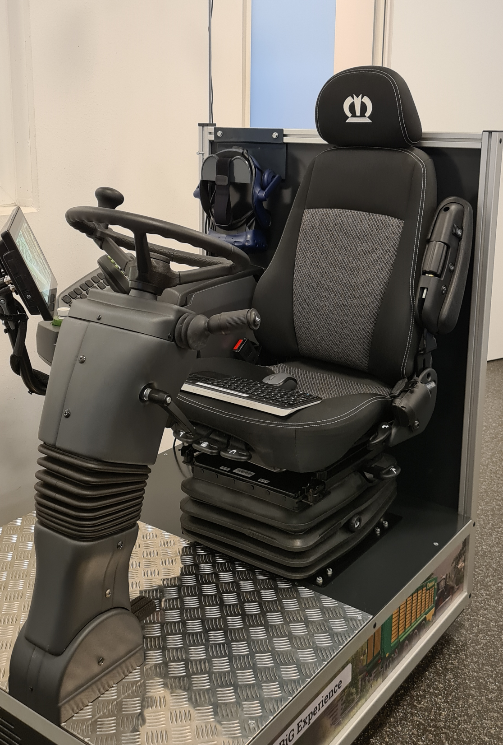

implementation
installing the VR simulator vorpX
  program for hooking up a big variety of games with VR glasses
because of corporate network a lot of IT work had to be done
  ordering of the program
  installing it with administrator rights
  starting up the VR headset and making adjustments

Slide 9
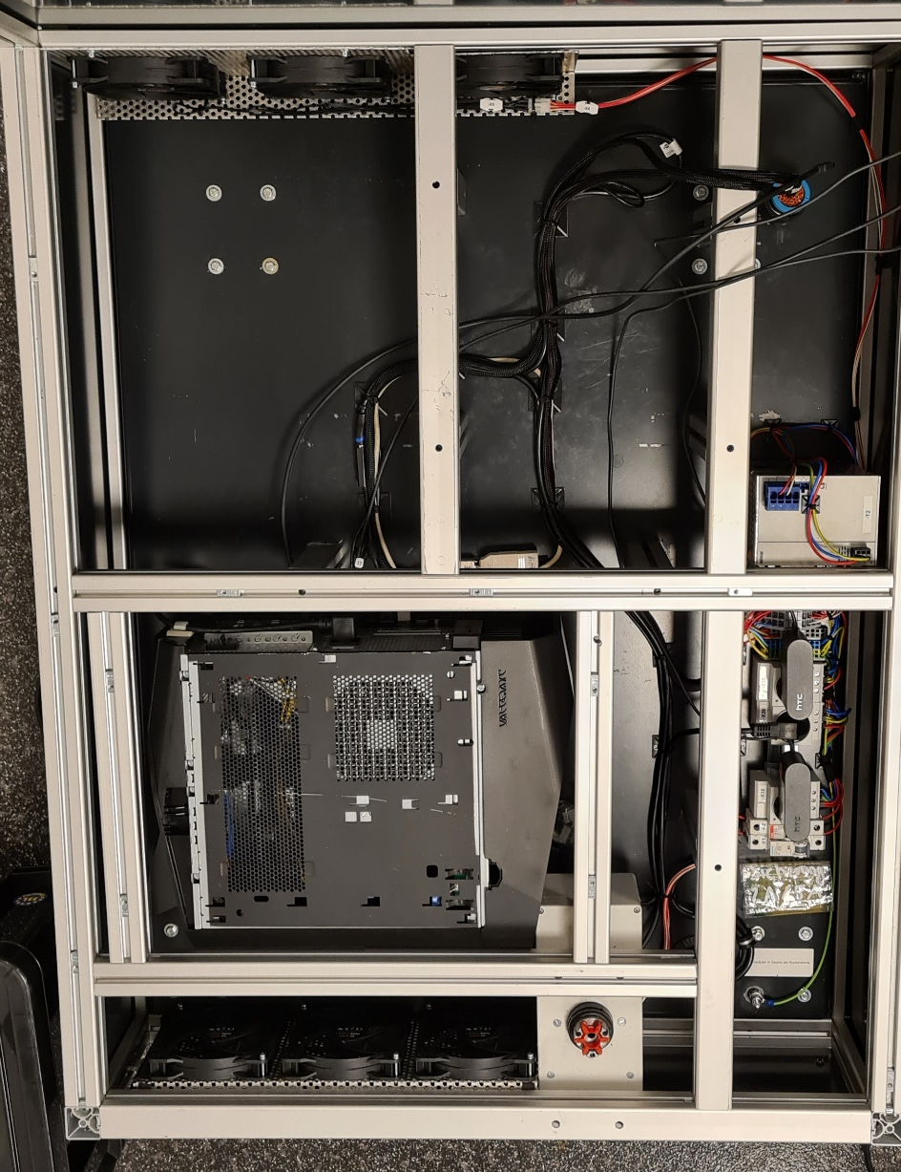
Implementation
running tests to find problems and failure
  pc was overheating
  more power outlets were needed
  infrared sensors needed an adjustable attachment
  storage option for the glasses
mechanical and electrical modification

Slide 10
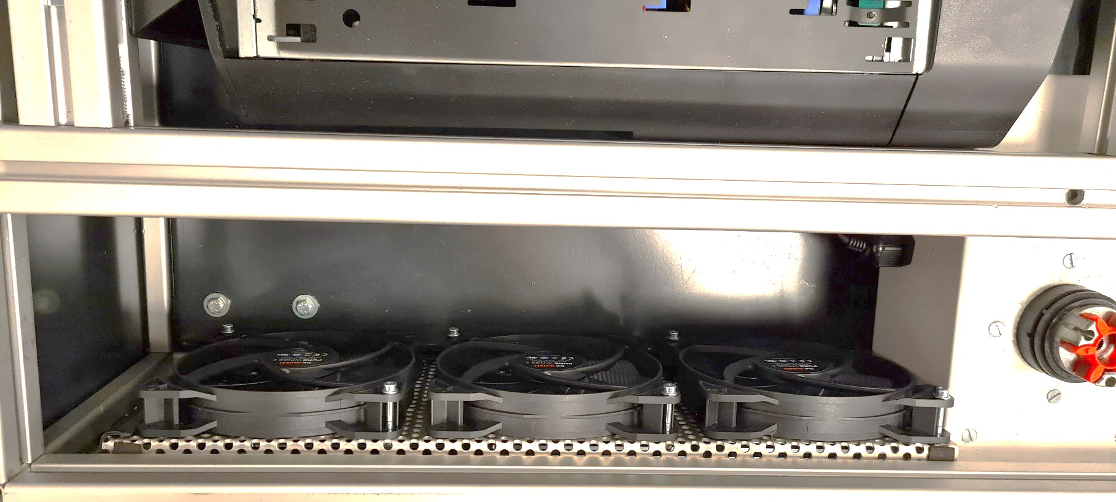
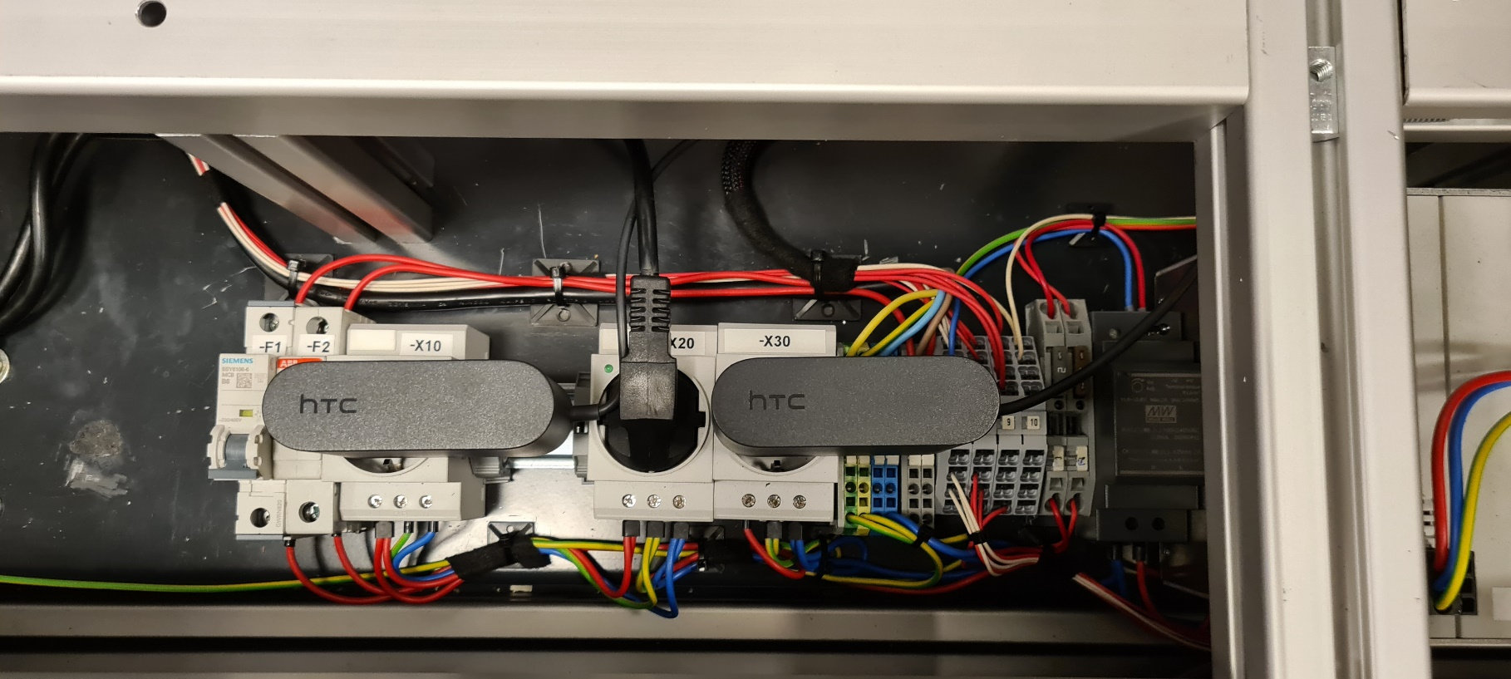
outcome electrical parts
build in 6 beQuiet! fans for cooling of the casing
3 new power outlets for internal wirering

Slide 11
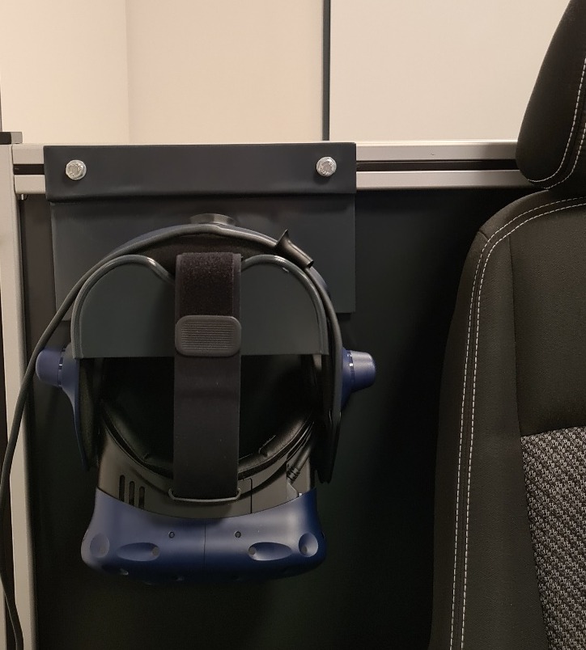
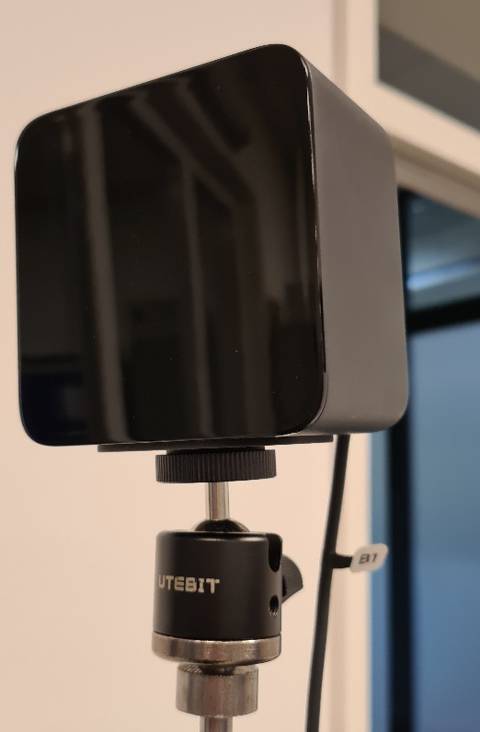
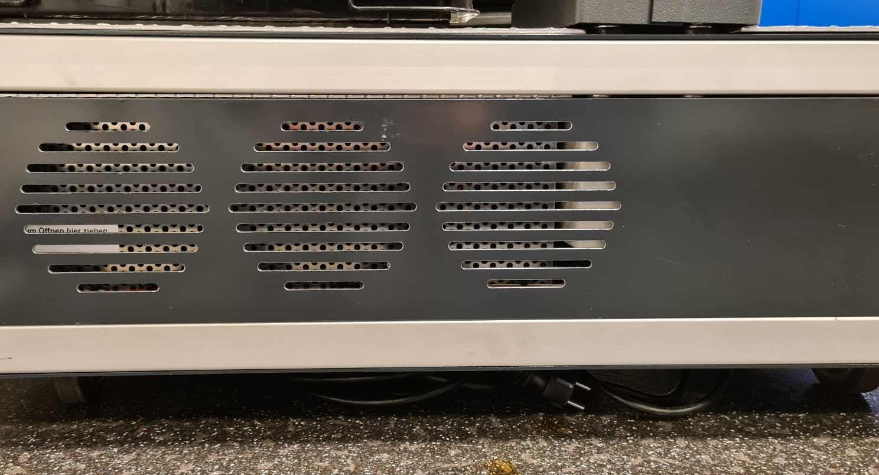
outcome mechanical parts
welded storing part for the glasses
sensor is attached to a metal pole (hight adjustment) and a ball joint (angle adjustment)
milled ventilation slots in the front and in the back

Slide 12
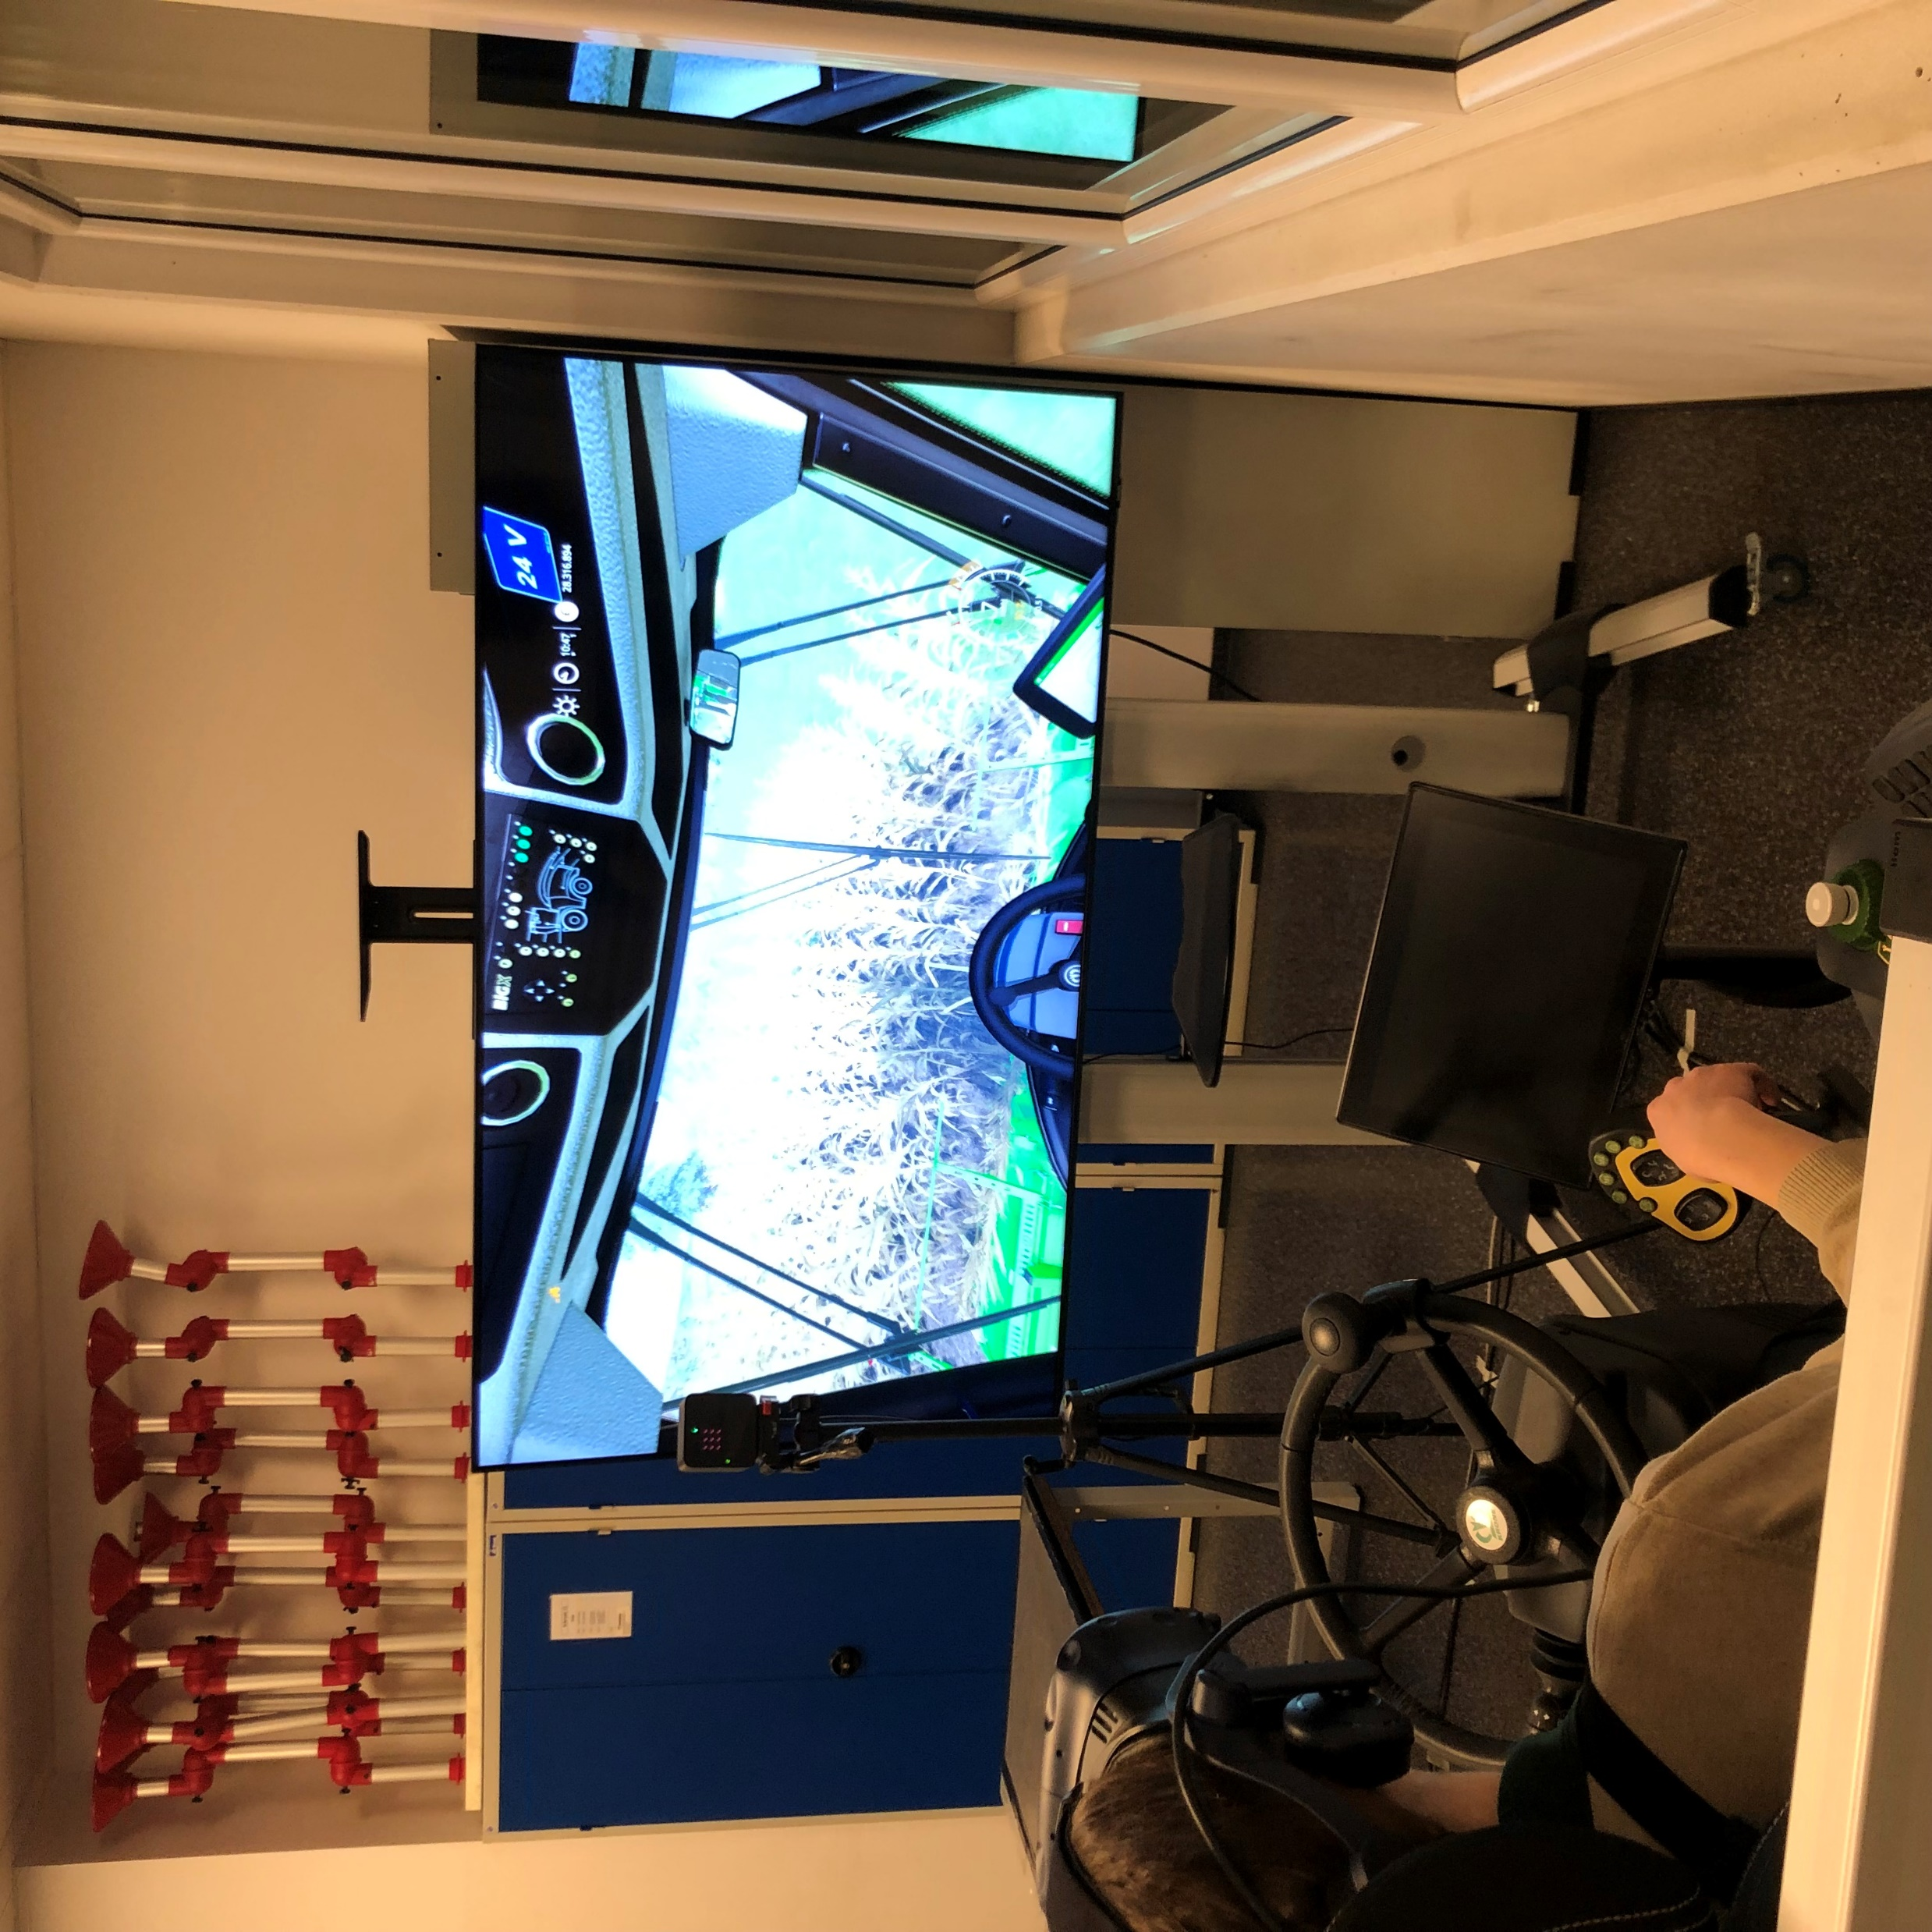
outcome
a semi-realistic experience of driving a BIG X
still needs extra features which will be worked on in the future

Slide 13

Thank you for your attention!

