Slide 1



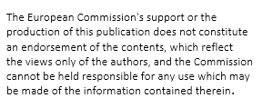
WorkShop da Bomb
Erasmus project - Arveti 4.0

Slide 2
Welkom
During this workshop you will experience
Virtual reality yourself
discover the importance of communication

Slide 3

You are alone in an isolated room with a bomb. Fortunately you have friends that are experts in defusing bombs and they have access to the manual for “your” bomb.
However…
there is a catch… The experts are in a different location and can not see the bomb, so they have to talk you through it …. Mind that there is a time limit !!!

Slide 4
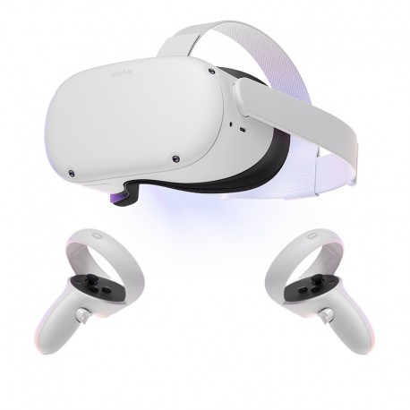
Oculus Quest 2
The Oculus Quest 2 will be used during this workshop.
One of the team will wear the oculus, the others will have access to the manual.
Participants will change roles after a session
Several sessions will be held with afterwards an evaluation

Slide 5
Round 1
Good luck!

Slide 6

Evaluation Round 1
What has happened?
What do you need from the other person?
What will you change when you play again?

Slide 7
Round 2
Good Luck!

Slide 8
Evaluation Round 2
What was different?
Did it work better? what?
Is there something else you would like to change to improve even more?

Slide 9
Round 3
Good luck!

Slide 10
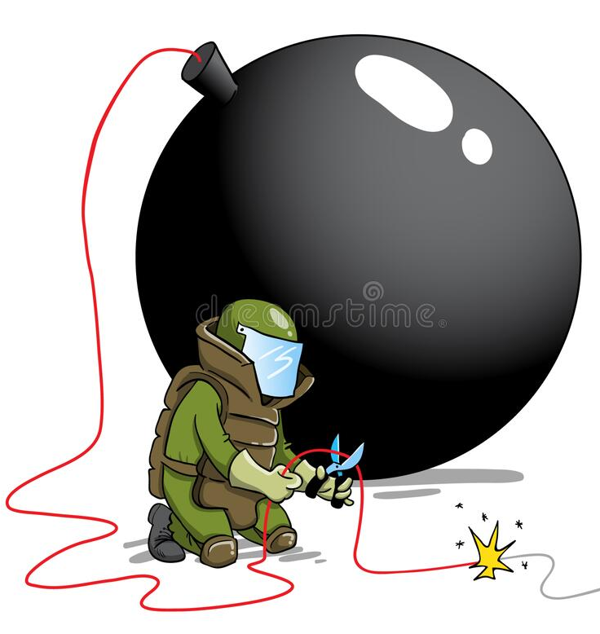
Evaluation workshop
How did you experience this workshop?
In terms of communication; what went well and what needs improvement?
Is there something that could have improved the entire process that we could have provided?

Slide 11


